Slide 1
My 9 weeks in Greenfox
 
 
 
 
Hardware programming course 2017/2018

Slide 2

About my background...
Mechanical engineer
CAD designer
Former programming experience
(Php, Html, JS, CSS, MySQL, BS)

Slide 3

Achieved software knowledge:
C
C++ & OOP

Slide 4
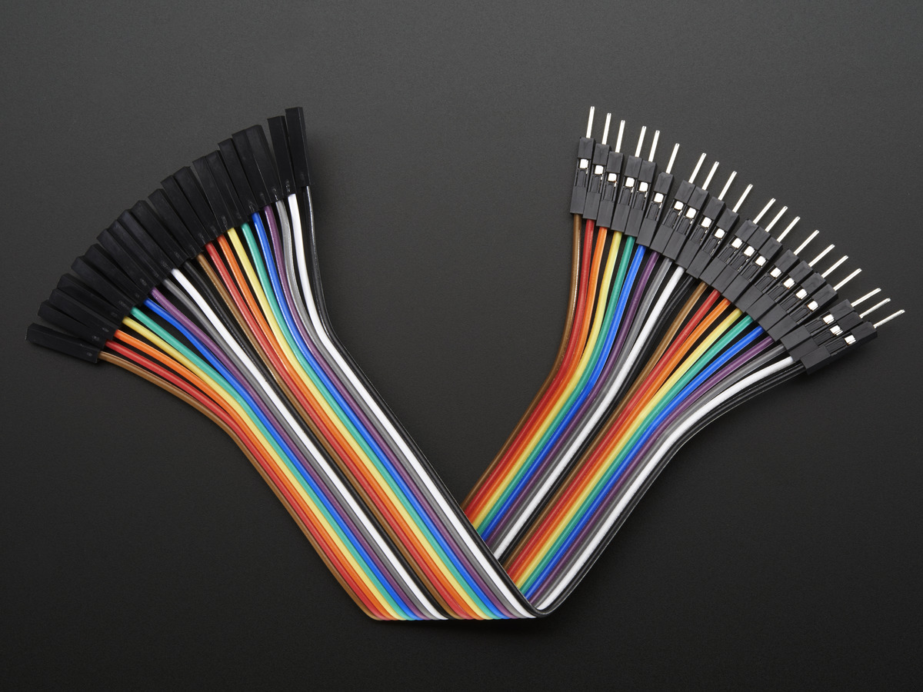
Hardware…
GPIO ports
Registers & bitwise R/W
Timers
PWM signal generation
IRQ (ext. & int.)

Slide 5
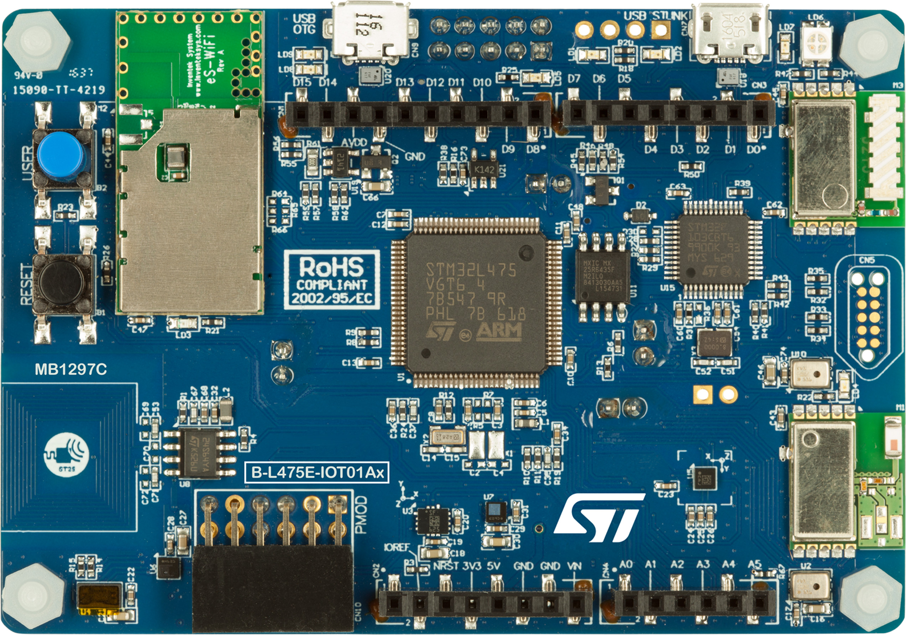
Main hardware projects
LED controlling through GPIO ports
User inputs through buttons
Using timers for task automation
PWM for blinking/dimming LED & motor speed control
Handling interrupts

Slide 6

Thank You for your attention!

